Slide 1

Solar Radiation Forecasting & Prediction using Machine learning
Under the supervision of :
Mrs. Deeksha Chandola
By:-
Sanjeev kumar(9917102033)
Aparajit Verma(9917102050)
Shuddhatm Jain(9917102064)

Slide 2
Contents
Problem Statement.
Abstract.
Data Used.
Model Used.
Introduction.
Future Work.
Conclusion .
References .
Acknowledgement.

Slide 3
Problem Statement:
To predict the solar radiation of four cities and forecast its values upto next one year
Reason to choose the project:
Integration of solar energy into the electricity network is becoming essential because of its continually increasing growth in usage. An efficient use of the fluctuating energy output of photovoltaic (PV) systems requires reliable forecast information. In fact, this integration can offer a better quality of service if the solar irradiance variation can be predicted with great accuracy.

Slide 4
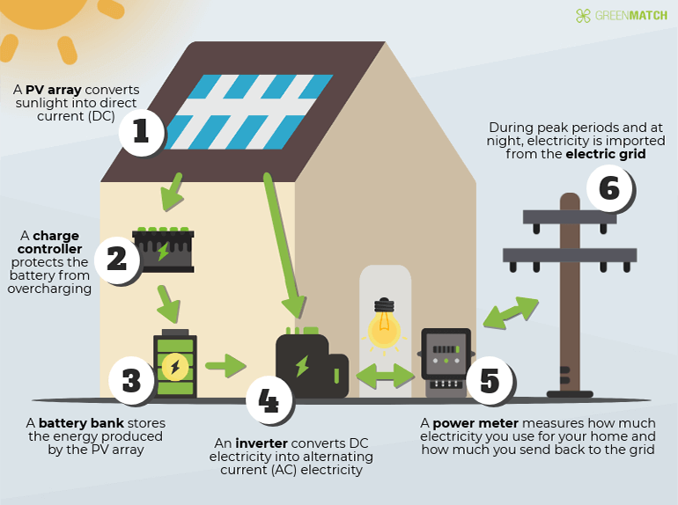

Slide 5
Abstract
A classification forecasting framework based on pattern recognition is developed for 1-hour-ahead global horizontal irradiance (GHI) forecasting.
The first set of model forecast GHI for each hour, then the GHI values in the remaining hours are forecasted by an optimal machine learning model determined based on a weather pattern classification model in the set. The weather pattern is determined by SARIMAX classifier .

Slide 6
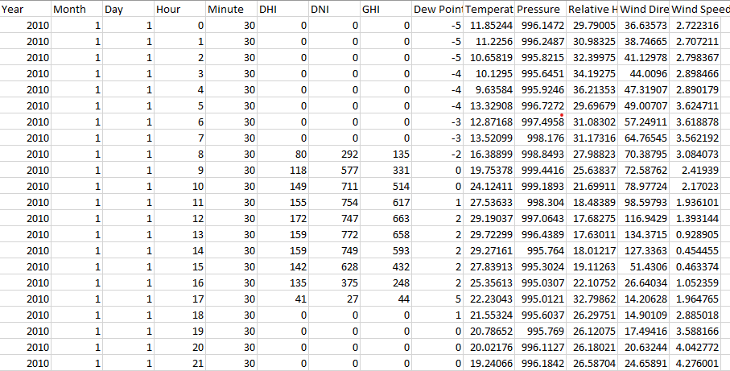
Data used city-wise
We have the dataset of 43801 rows and 14 columns(Year, Month, Day,Hour,Minute,DHI,DNI,GHI,Dew Point,Tempreture,Pressure,Relative Humidity,Wind Direction,Wind Speed)
City
Jaisalmer Jodhpur Bikaner Barmer

Slide 7
Model Used
SARIMAX
Seasonal Auto Regressive Integrated Moving Average
ARIMA
Auto Regressive Integrated Moving Average

Slide 8
Introduction
Seasonality
p is the auto-regressive part of the model. It allows us to incorporate the effect of past values into our model.
d is the integrated part of the model. This includes terms in the model that incorporate the amount of differencing.
q is the moving average part of the model. This allows us to set the error of our model as a linear combination of the error values observed at previous time points in the past .
Exogenous variables

Slide 9
Flow Chart
Input data with other exogenous variables
Perform SARIMAX forecasting
Get Minimum AIC and BIC
Use different values of p,d,q .
Get Minimum AIC
Perform SARIMAX forecasting
Get Result and then prediction
Plot Forecast
Show Forecast accuracy(RMSE,MAE,MAAPE)

Slide 10
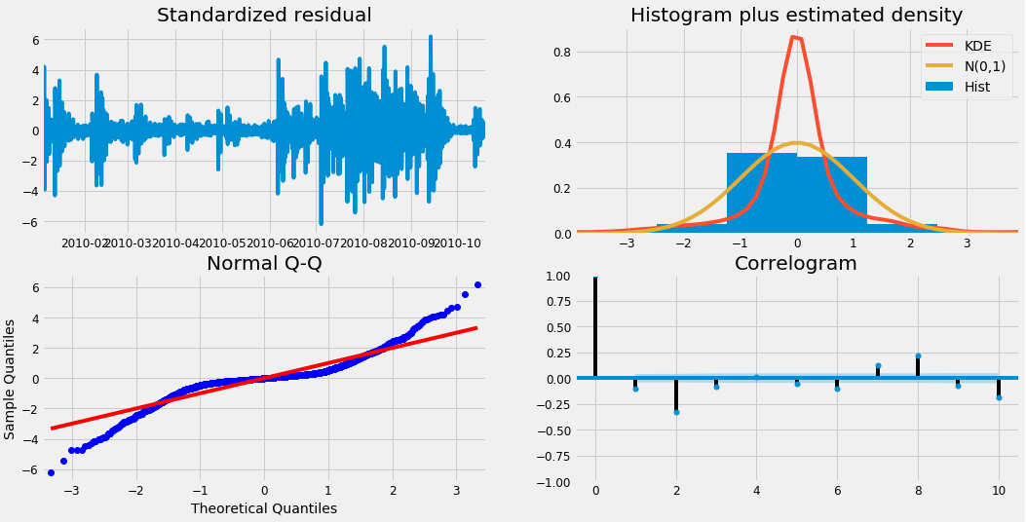
Plotting the diagnostics

Slide 11
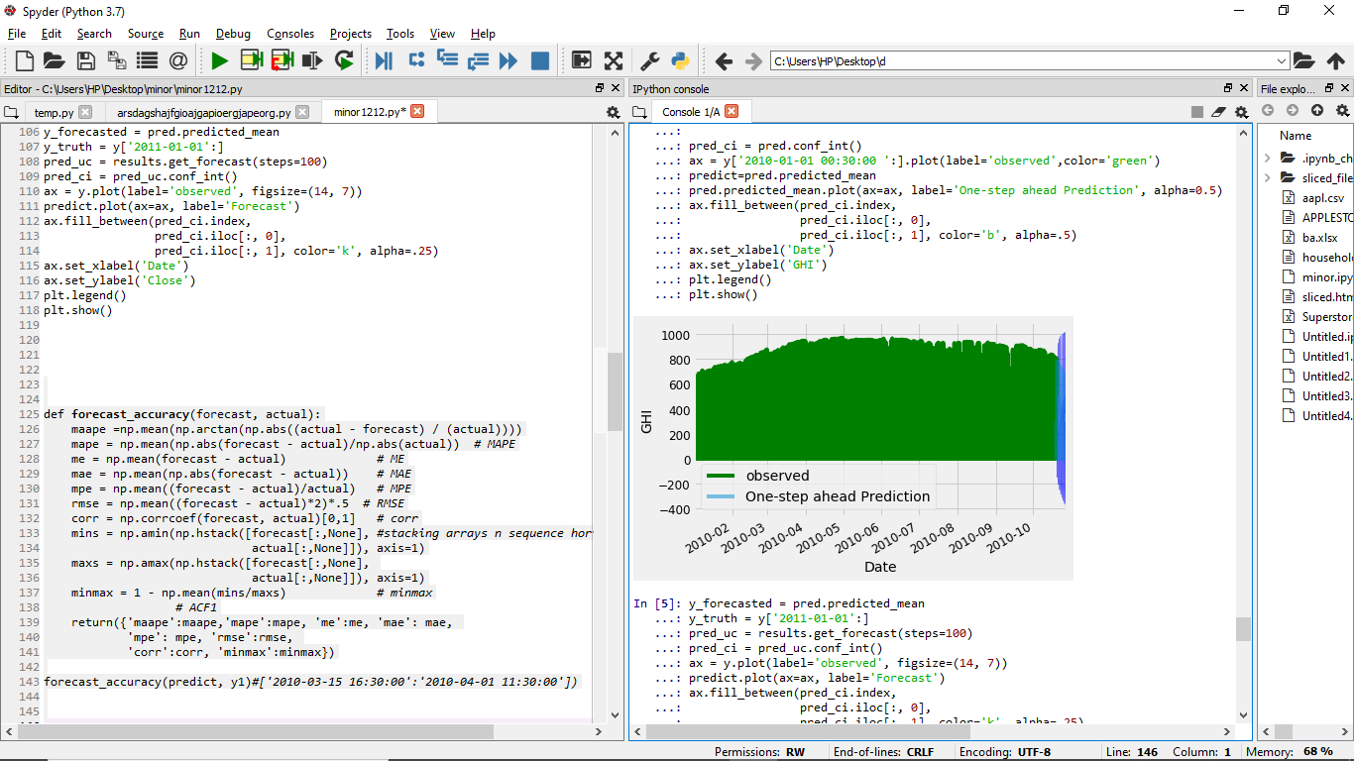
Predicted plot

Slide 12
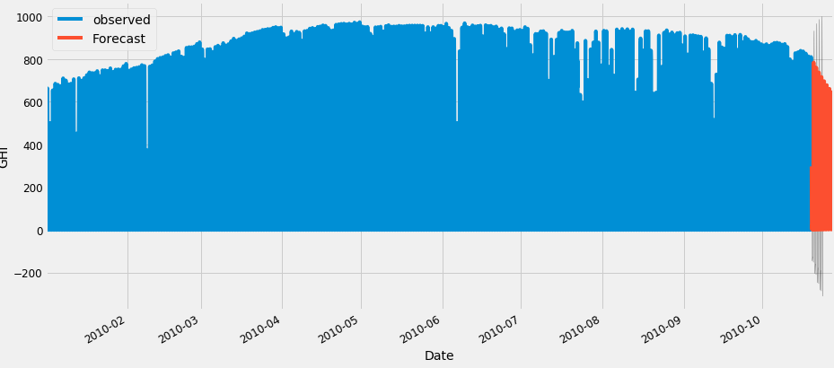
Result after Forecasting of the model

Slide 13
Results after applying ARIMA on model
RMSE | 12.297625640100827
MAAPE | 0.9083688447524527
MAE | 51.978194562926575
CORR | 0.9837959397455255
MINMAX | 0.5922016558653297

Slide 14
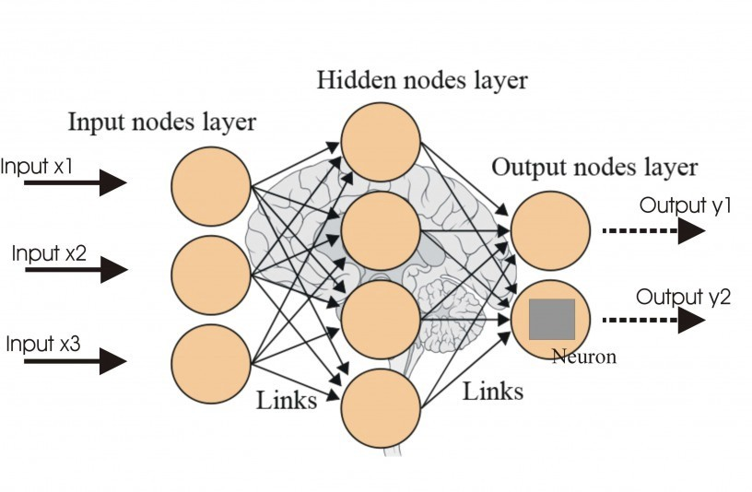
ANN (Artificial neural network)

Slide 15
ANN(artificial neural network)
ANNs are a family of computational machine learning algorithms inspired by the way biological nervous systems process and learn from information. ANNs consist of a large number of interconnected nodes, called neurons, that work together to learn and identify patterns.
They have three or more layers:
one input layer consisting of one or more neurons
one or more hidden layers where the learning occurs
one output layer.
The neurons in this interconnected network send signals to each other along weighted connections. The most common variant of ANNs used in PM2.5prediction is a feedforward ANN in which signals travel in one direction from input neurons (explanatory variables) to output (response variable).

Slide 16
Activation function
In artificial neural networks, the activation function of a node defines the output of that node given an input or set of inputs. A standard computer chip circuit can be seen as a digital network of activation functions that can be "ON" or "OFF" , depending on input. This is similar to the behavior of the linear perceptron in neural networks.
However, only nonlinear activation functions allow such networks to compute nontrivial problems using only a small number of nodes. In artificial neural networks, this function is also called the transfer function .

Slide 17
Hybrid model (Ann-arima)
ARIMA and ANN are good in linear and nonlinear domains but none of them is a universal model that is suitable for all circumstances. The approximation of ARIMA model for complex nonlinear problems may not yield good results similarly, ANN will give mixed results in the linear domain. Since it is difficult to completely know the characteristics of the data in a real problem, a hybrid methodology that has both linear and nonlinear modeling capabilities can be a good strategy for practical use. By combining different models, different aspects of the underlying patterns may be captured.

Slide 18
Flow Chart
Get the database
Perform SARIMAX forecasting
Get Minimum AIC and BIC
Divide into Train & Test(1320 rows, 680 rows) (with exogenous variables)
Predict Par(dynamics)
Test values(from 1320to1999)
Perform SARIMAX on train rows value of P D Q = range from 0to2
seasonal order = 12
Get results and plot diagnotics
Get Accuracy(MAAPE =1.005
RMSE = 262.16)
Find Residuals (i.e TEST - Far)
Implement ANN
Using Train x,Train y (680 rows,680 rows)
With 50 Neurons , 25 Sub-neurons(hidden layer)
500 EPOCH , 512 batch size
Get Prediction
Determine Error(test residuals,Pan)
(MAAPE = 0.09
RMSE = 18.96)

Slide 19
Results after applying hybrid (ann –ARIMA) on model
RMSE
MAAPE
MAE
CORR
MINMAX

Slide 20
Future Work
We’ll be using other techniques in Machine Learning ( like ANN ) and will combine with SARIMAX model thus making it a Hybrid model.

Slide 21
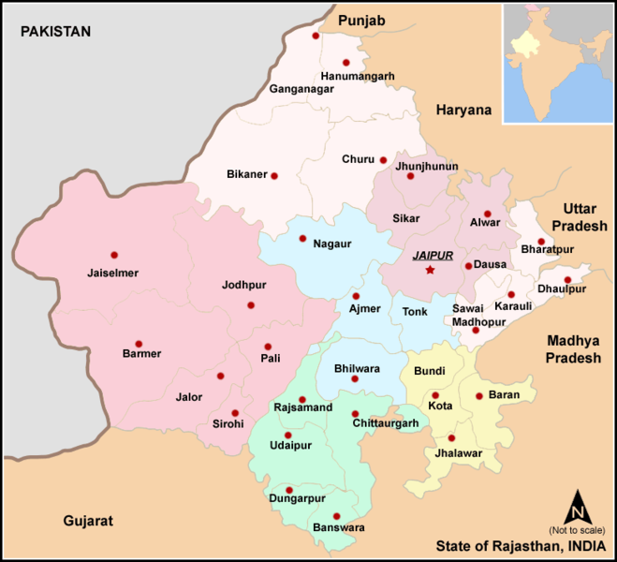
Rajasthan map (bikaner , jaiselmer , barmer , jodhpur ) :

Slide 22
Conclusion
In this project, we have validated SARIMAX model in Python to find the accuracy of forecasts. We made extensive use of the pandas and stats models libraries and showed how to run model diagnostics, as well as how to produce forecasts of the GHI (solar radiation) time series.

Slide 23
References (research paper)
[1] Ariyo, Adebiyi A., Adewumi O. Adewumi, and Charles K. Ayo. "Stock price prediction using the ARIMA model." 2014 UKSim-AMSS 16th International Conference on Computer Modelling and Simulation. IEEE, 2014.
[2] Diagne, Maimouna, et al. "Review of solar irradiance forecasting methods and a proposition for small-scale insular grids." Renewable and Sustainable Energy Reviews 27 (2013): 65-76.
[3] Trapero, Juan R., Nikolaos Kourentzes, and Alberto Martin. "Short-term solar irradiation forecasting based on dynamic harmonic regression." Energy 84 (2015): 289-295.
[4] Huang, Rui, et al. "Solar generation prediction using the ARMA model in a laboratory-level micro-grid." 2012 IEEE Third International Conference on Smart Grid Communications (SmartGridComm). IEEE, 2012.
[5] Mircetic, Dejan, et al. "Development of S-ARIMA Model for Forecasting Demand in a Beverage Supply Chain." Open Engineering 6.1 (2016).
Kim, Sungil, and Heeyoung Kim. "A new metric of absolute percentage error for intermittent demand forecasts." International Journal of Forecasting 32.3 (2016): 669-679.
[6] Yang, Dazhi, Panida Jirutitijaroen, and Wilfred M. Walsh. "Hourly solar irradiance time series forecasting using cloud cover index." Solar Energy 86.12 (2012): 3531-3543.
[7] Bouzerdoum, M., A. Mellit, and A. Massi Pavan. "A hybrid model (SARIMA–SVM) for short-term power forecasting of a small-scale grid-connected photovoltaic plant." [8]Solar Energy 98 (2013): 226-235.
[9] Velasco, Lemuel Clark P., et al. "Load forecasting using autoregressive integrated moving average and artificial neural network." INTERNATIONAL JOURNAL OF ADVANCED COMPUTER SCIENCE AND APPLICATIONS 9.7 (2018): 23-29.

Slide 24
Acknowledgement
Special thanks to MRS. Deeksha Chandola Mam for their unconditional support , patient guidance, encouragement and advices she has provided throughout our work .

Slide 25
THANK YOUYou

